Slide 1
J.K. Placements Database Manager Application
Submitted by
SOUHAM BISWAS
B.Tech CSE Vth Sem.

Slide 2
Application Features
Cloud Connectivity –
The data being queried resides on an online MySQL Server. This ensures that the data remains in sync across all machines running this application.
Interactive User Interface –
The application being a WPF(Windows Presentation Foundation) based application, allowed it to be aesthetically beautified using XAML scripts. Beautification refers to the chrome, transparency and animation effects in the application.

Slide 3
Compatibility across windows platforms –
The application needs a minimum of .NET 4.0 runtime. Since most versions of Windows Operating Systems come pre-installed with .NET 4.0, hence this application is compatible with most windows PCs.
Security –
The data in the database can only be viewed by any user without password authentication. Otherwise, password authentication is required for performing any sort of modification on the data or even for changing any sort of database connection settings.

Slide 4
Advanced Features –
The application creates a hidden and read-only file in the location where the app is situated on the hard drive.
Logging –
This file contains all the server connection settings, and also a log of all the SQL queries being passed in the background to the MySQL server is stored in this file.
The queries passed are enclosed within timestamps denoting as to when the user started the application and when it was stopped.
Data Restore-
In the event of any software or hardware failure, or even in the case of unauthorized database access, this log file can be utilized to recover the lost data by manually passing all the insertion queries which were passed earlier, or maybe used to undo any unwanted changes by analysing the SQL queries.

Slide 5
Intruder Pinpointing –
The fact that the log file stores the SQL queries passed alongwith the timestamp, may help to show at what time any unauthorized change (if any) were made, which can help to enumerate the person responsible for it.
Data Export-
The application allows the user to export all the data in the database as a document file with all the information correctly parsed, formatted and in a serially readable form.
This document maybe be transferred or printed out.

Slide 6
Software Pre-requisites -
.NET 4.0 Runtime
The fact that it is .NET 4.0 based allows it to run on most Windows based machines, as .NET 4.0 is shipped by default alongwith all Windows Operating Systems.
MySQL Connector NET 6.6.5
The application generates the appropriate SQL queries for data management for the backend database, and the connector is responsible for passing them to the database.
Internet connection
This, being a cloud connected application, obviously requires an internet connection as the database holding the data can only be accessible through the internet.

Slide 7
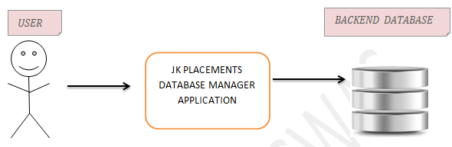
Software Overview -
This software is basically a graphical interface between the backend MySQL Database server and the user.

Slide 8
The software allows the user to perform all the basic C.R.U.D (Create, Read, Update, Delete) operations on the database.
Details about the companies contacted by the college for placements, such as records of all contacts (phone number, email), when the company was approached by college, their response, the stream (CSE or ECE) for which they’re interested and a log of the placement cell related pending jobs pertaining to each company.

Slide 9
Database Schema-
The database linked to the app is called “placements” by default and contains the following tables –
Company
This table has the following columns –
CompanyNum
CompanyName
DateOfApproach
Comments

Slide 10
Contacts
This table has the following columns –
ContactID
CompanyName
ContactPerson
Position
ContactNos
This table has the following columns –
ContactID
CompanyName
ContactPerson
ContactNum
ContactEmail

Slide 11
Pending
This table has the following columns –
PendingJobID
CompanyName
PendingJob
FinalDate
JobStatus

Slide 12
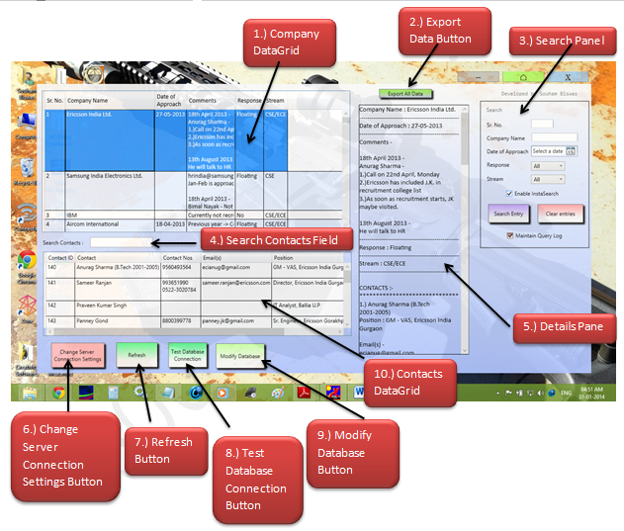
Software Workings-
MainPage.xaml-

Slide 13
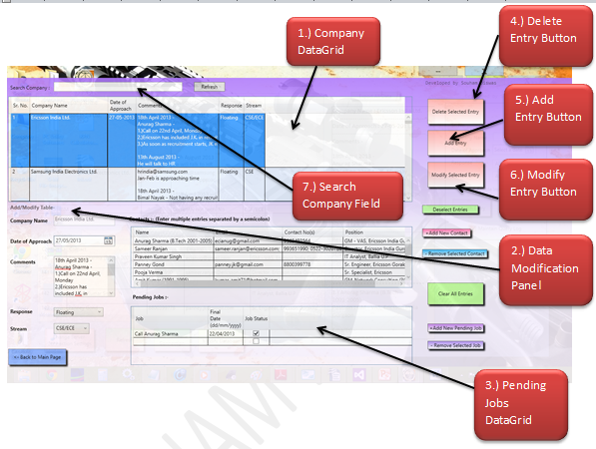
DBModifyPage.xaml

Slide 14
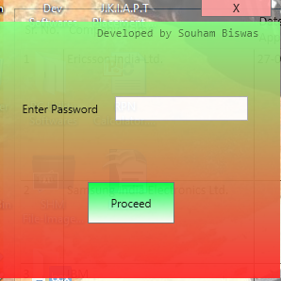
ServerConnectionSettingsAuthorization.xaml

Slide 15
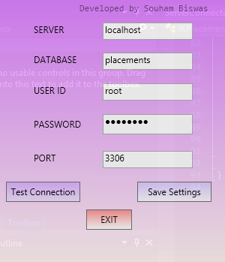
ServerConnectionSettings.xaml

Slide 16
Custom Classes -
DBConnect-
This class encapsulates the connection logic between the front-end application and the back-end database.
DataModder –
This class encapsulates logic for SQL string generation, and handling of the C.R.U.D (Create, Read, Update, Delete) operations on the database.

Slide 17
Development Softwares Used -
Visual Studio 2012-
Visual Studio Software is a comprehensive software development IDE from Microsoft which allows for software development for any windows based platform in various languages.
Since this application is .NET based, hence this IDE was utilised.
MySQL Workbench-
This provides a graphical interface to the back-end MySQL databases during development time.

Slide 18
Bibliography
www.stackoverflow.com
www.codeproject.com
www.dreamincode.com
www.msdn.microsoft.com
www.google.com
www.wikipedia.org
www.forums.mysql.com

